Slide 1
2D Drawing Basics
1

Slide 2
Overview
2D coordinate systems
Images
Sprite drawing in XNA

Slide 3
Coordinate System
A coordinate system is a system which uses one or more numbers, or coordinates, to uniquely identify the position of a point
For a 2D coordinate system, we need
Origin
2-Tuple of a position relative to the origin

Slide 4
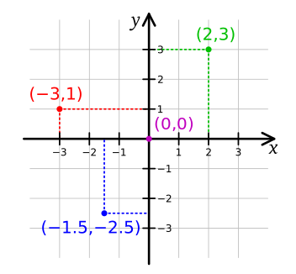
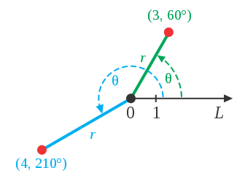
2D coordinate system examples
Cartesian Coordinates
(http://en.wikipedia.org/wiki/File:Cartesian-coordinate-system.svg)
Polar Coordinates
(http://en.wikipedia.org/wiki/File:CircularCoordinates.svg)

Slide 5
XNA’s coordinate system

Slide 6
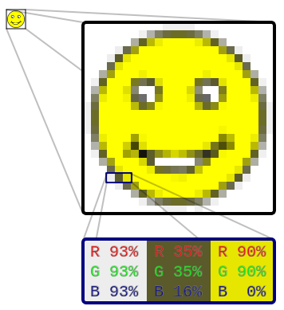
Images
http://en.wikipedia.org/wiki/File:Rgb-raster-image.svg

Slide 7
Image Formats (extensions)
PPM
Uncompressed, human readable
GIF
8 bits per pixel (bpp) per channel (RGB)
256 different colors
Lossless data compression (LZW “patented”)
JPEG
Lossy data compression
PNG – Portable Network Graphics
Created as an improved, non-patented replacement for GIF
supports palette-based images (with palettes of 24-bit RGB or 32-bit RGBA colors), grayscale images (with or without alpha channel), and full-color non-palette-based RGB[A] images
Lossless data compression

Slide 8
Sprite drawing in XNA
SpriteBatch object
Begin – called once to start specifying the “batch” of Sprites to draw
Draw – called for each Sprite needing to be drawn
End – called once to finish specifying the “batch” of Sprites to draw

Slide 9
?

Slide 10
References

